Slide 1
Natural Language Processing
Dr. Vijayalakshmi Anand
BITS Pilani

Slide 2
Neural Language Model

Slide 3


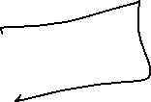

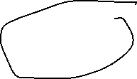
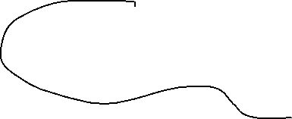



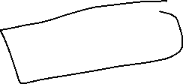








Types of language model
Statistical model
Neural language model

Slide 4


Probabilistic Language Models
Probability of a sequence of words:
Conditional probability of an upcoming word:
Chain rule of probability:
(n-1)^{th} order Markov assumption
Each p(w_{i}|w_{i−4}, w_{i−3}, w_{i−2}, w_{i−1}) may not have enough statistics to estimate
we back off to p(w_{i}|w_{i−3}, w_{i−2}, w_{i−1}), p(w_{i}|w_{i−2}, w_{i−1}), etc., all the way to p(w_{i})

Slide 5
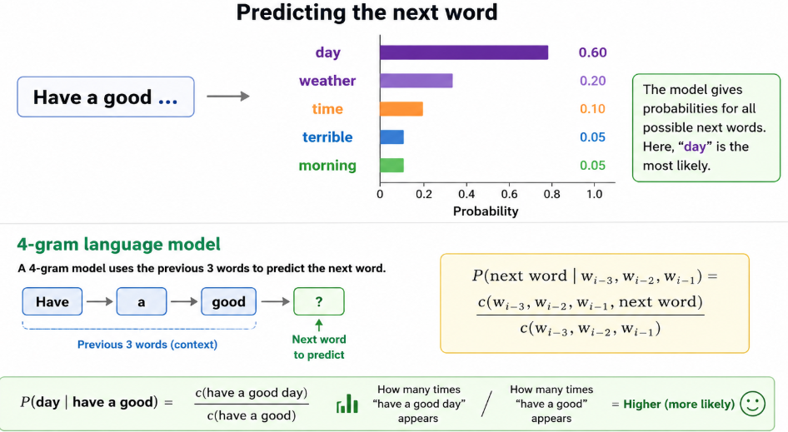









Example

Slide 6




Curse of dimensionality
Consider this sentences
Have a good day
Have a great day
What happens in smoothing ?

Slide 7
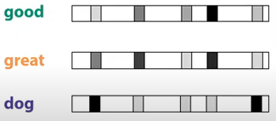








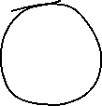


How to generalize better
Learn distributed representation of words
What is distributed representation?
also known as embedding.
Eg:

Slide 8
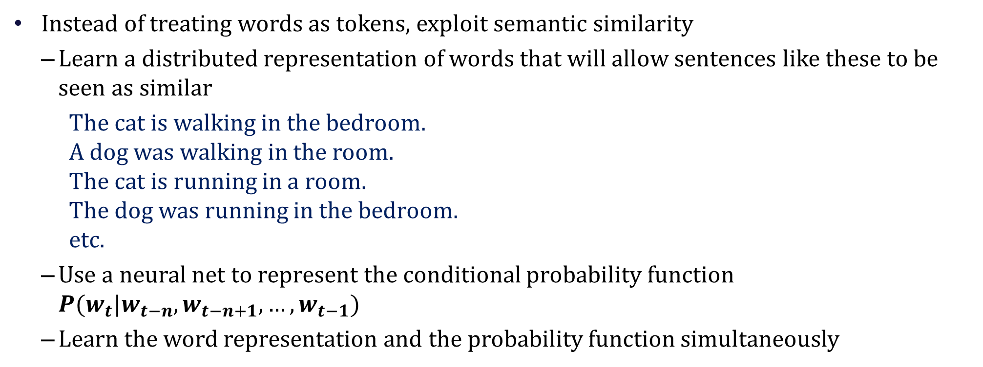



Neural Probabilistic Language Models
Instead of treating words as tokens, exploit semantic similarity
Learn a distributed representation of words that will allow sentences like these to be seen as similar
The cat is walking in the bedroom. A dog was walking in the room. The cat is running in a room. The dog was running in the bedroom. etc.
Use a neural net to represent the conditional probability function $P(w_{t}|w_{t−n},w_{t−n+1}, …, w_{t−1})$
Learn the word representation and the probability function simultaneously

Slide 9















Simple feedforward Neural Language Models
Task: predict next word w_{t}
given prior words w_{t-1}, w_{t-2}, w_{t-3}, …
Output : probability distribution over possible next words.
Problem: Now we’re dealing with sequences of arbitrary length.
Solution: Sliding windows (of fixed length)

Slide 10












Word Embeddings
one-hot vector representation , e.g., dog = (0,0,0,0,1,0,0,0,0,....), cat = (0,0,0,0,0,0,0,1,0,....)
Represent each of the N previous words as a one-hot vector of length |V| one-hot vector , i.e., with one dimension for each word in the vocabulary
word “toothpaste”, supposing it is V₅, i.e., index 5 in the vocabulary, x₅ = 1, and x_{i} = 0 i ∀≠ 5,
Embedding matrix
One-hot vector

Slide 11
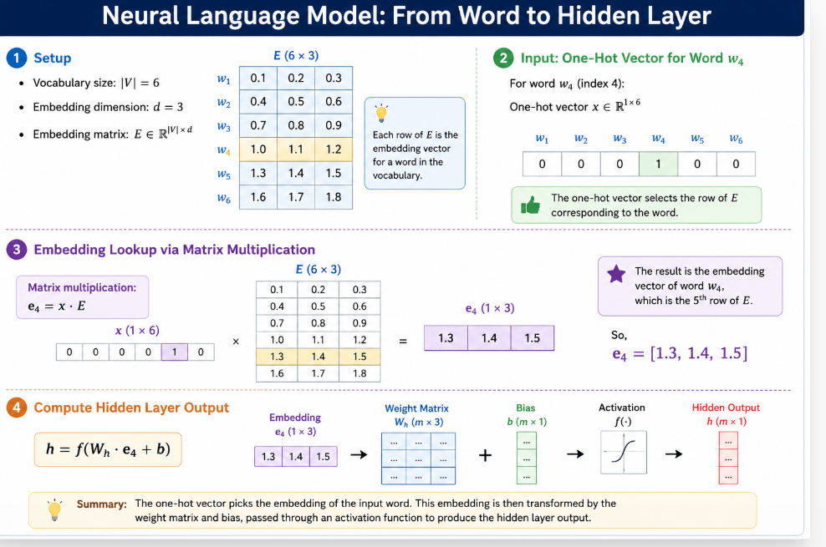

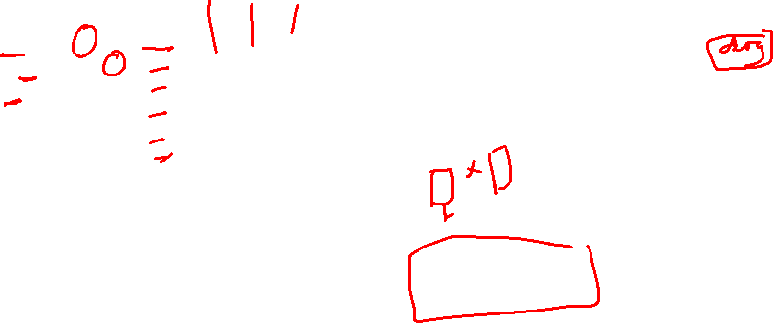

Slide 12









Why Neural LMs work better than N-gram LMs
embeddings
Neural language models represent words in this prior context by their embeddings, rather than just by their word identity as used in n-gram language models.
Using embeddings allows neural language models to generalize better to unseen data.
Training data:
We've seen: I have to make sure that the cat gets fed.
Never seen: dog gets fed
Test data:
I forgot to make sure that the dog gets ___
N-gram LM can't predict "fed"!
Neural LM can use similarity of "cat" and "dog" embeddings to generalize and predict “fed” after dog

Slide 13
Training the neural language model
Two ways:
Freeze the embedding layer E with initial word2vec values.
Freezing means we use word2vec or some other pretraining algorithm to compute the initial embedding matrix E, and then hold it constant while we only Modify W, U, and b, i.e., we don’t update E during language model training
Learn the embeddings simultaneously with training the network.
Useful when the task the network is designed for (like sentiment classification, translation, or parsing) places strong constraints on what makes a good representation for words.

Slide 14
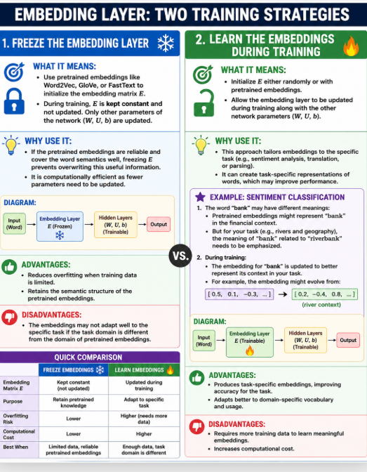
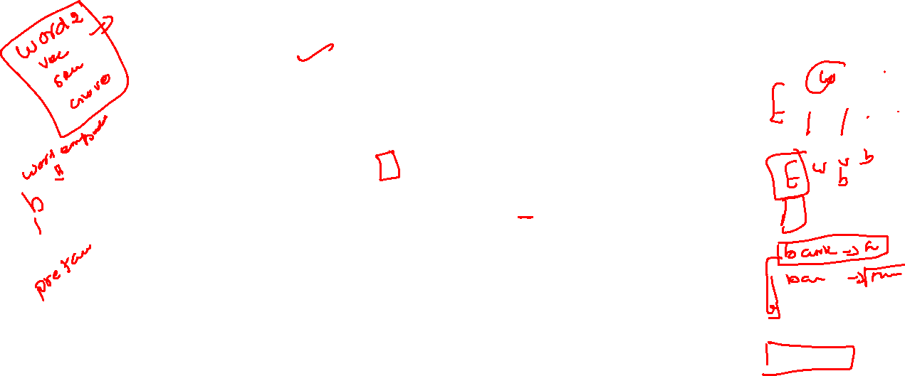

Slide 15









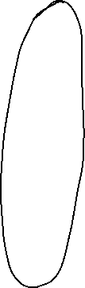















Training the neural language model
θ= E,W,U, b.
one single embedding dictionary E that’s shared among one-hot vectors
Training the parameters to minimize loss will result both in an algorithm for
language modeling (a word predictor)
but also a new set of embeddings E
that can be used as word representations
for other tasks.

Slide 16
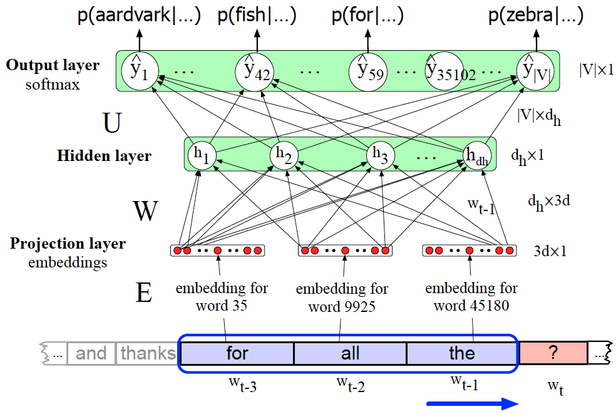


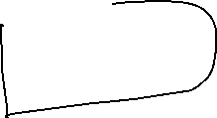






Neural Language Model
Equations:
concatenate 3 embeddings for the 3 context words to produce the embedding layer e

Slide 17
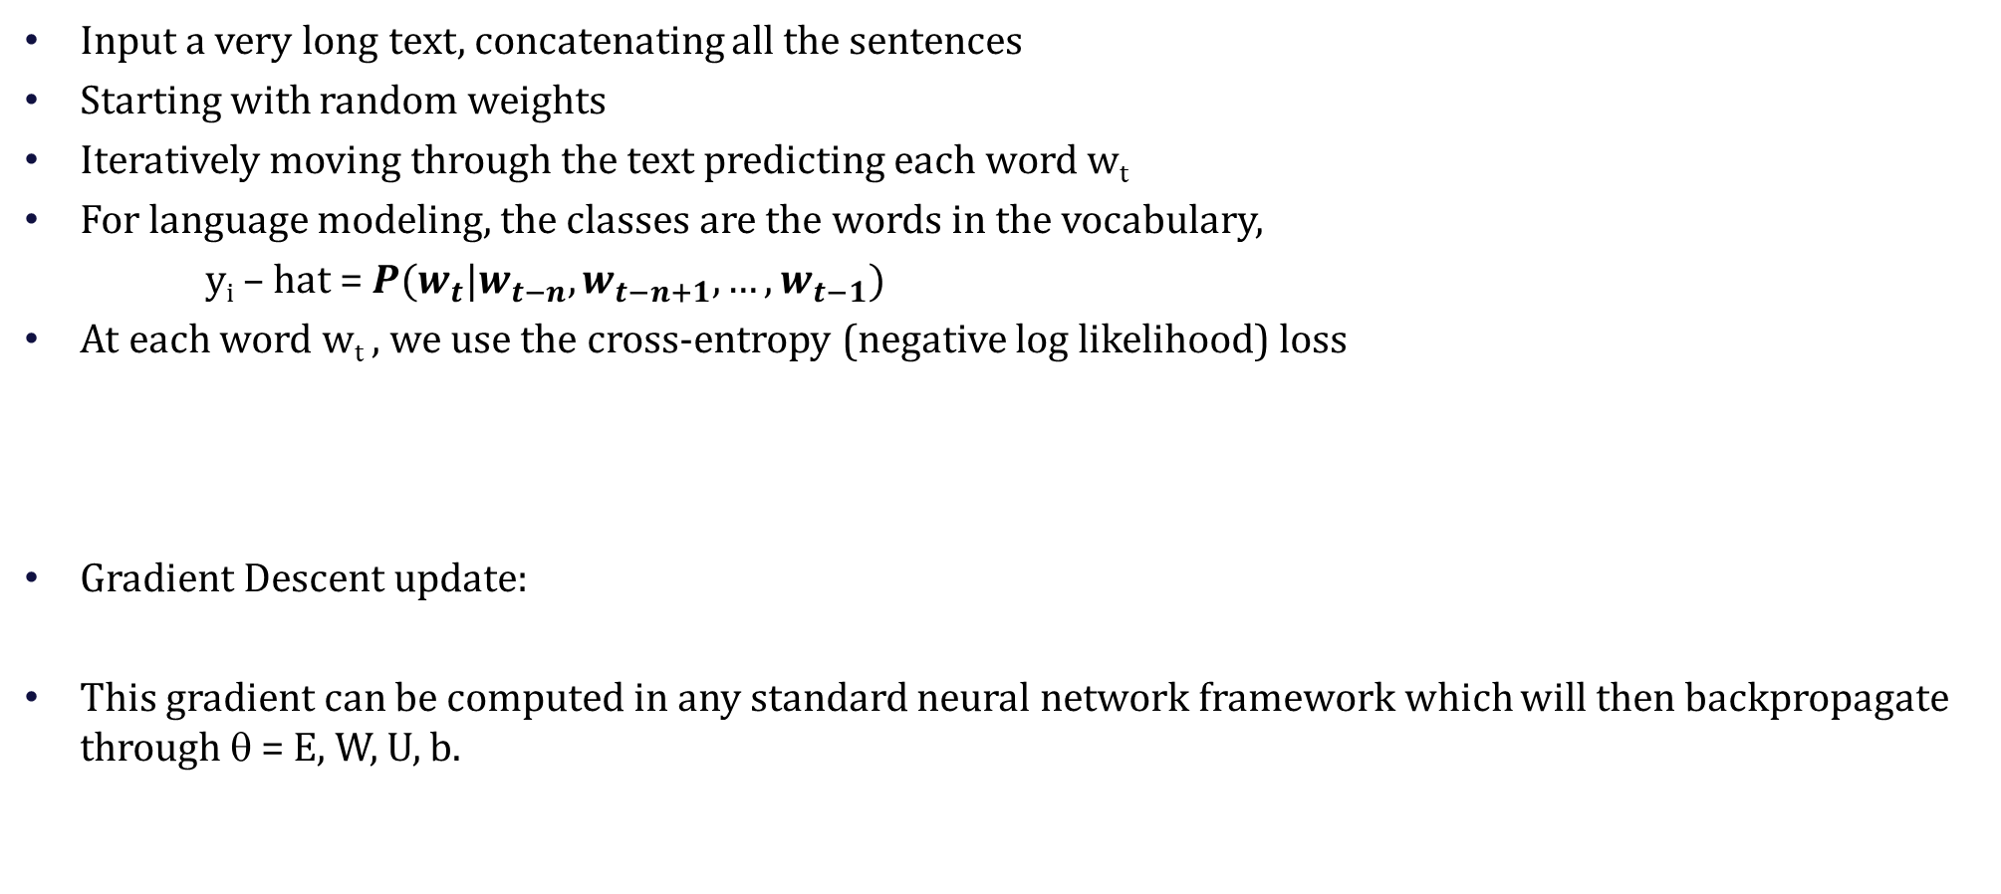
Training the neural language model
Input a very long text, concatenating all the sentences
Starting with random weights
Iteratively moving through the text predicting each word w_{t}
For language modeling, the classes are the words in the vocabulary,
y_{i} – hat = $P(w_{t}|w_{t−n},w_{t−n+1}, …, w_{t−1})$
At each word w_{t} , we use the cross-entropy (negative log likelihood) loss
Gradient Descent update:
This gradient can be computed in any standard neural network framework which will then backpropagate through θ = E, W, U, b.

Slide 18
References
CH-7 - Speech and Language Processing by Daniel Jurafsky

